Slide 1

Introduction to Reactjs
By Joey Chua
Notes:
Hi everyone! Welcome to the introduction to Reactjs course!

Slide 2
About Me
Joey Chua
Data Scientist @ Vertex
https://www.linkedin.com/in/joeychuasm/
Course Materials @ https://github.com/joeychuavertex/techladies-react-intro

Slide 3
About Me
Overview of React
Joey
Data Scientist @ Vertex
What is React
Why React
Using React
Create a simple app

Slide 4
Overview of React
What is React
Why React
Using React
Create a simple app
Why React?

Slide 5
It is easy to understand, has a large community, and is one of the most popular library

Slide 6
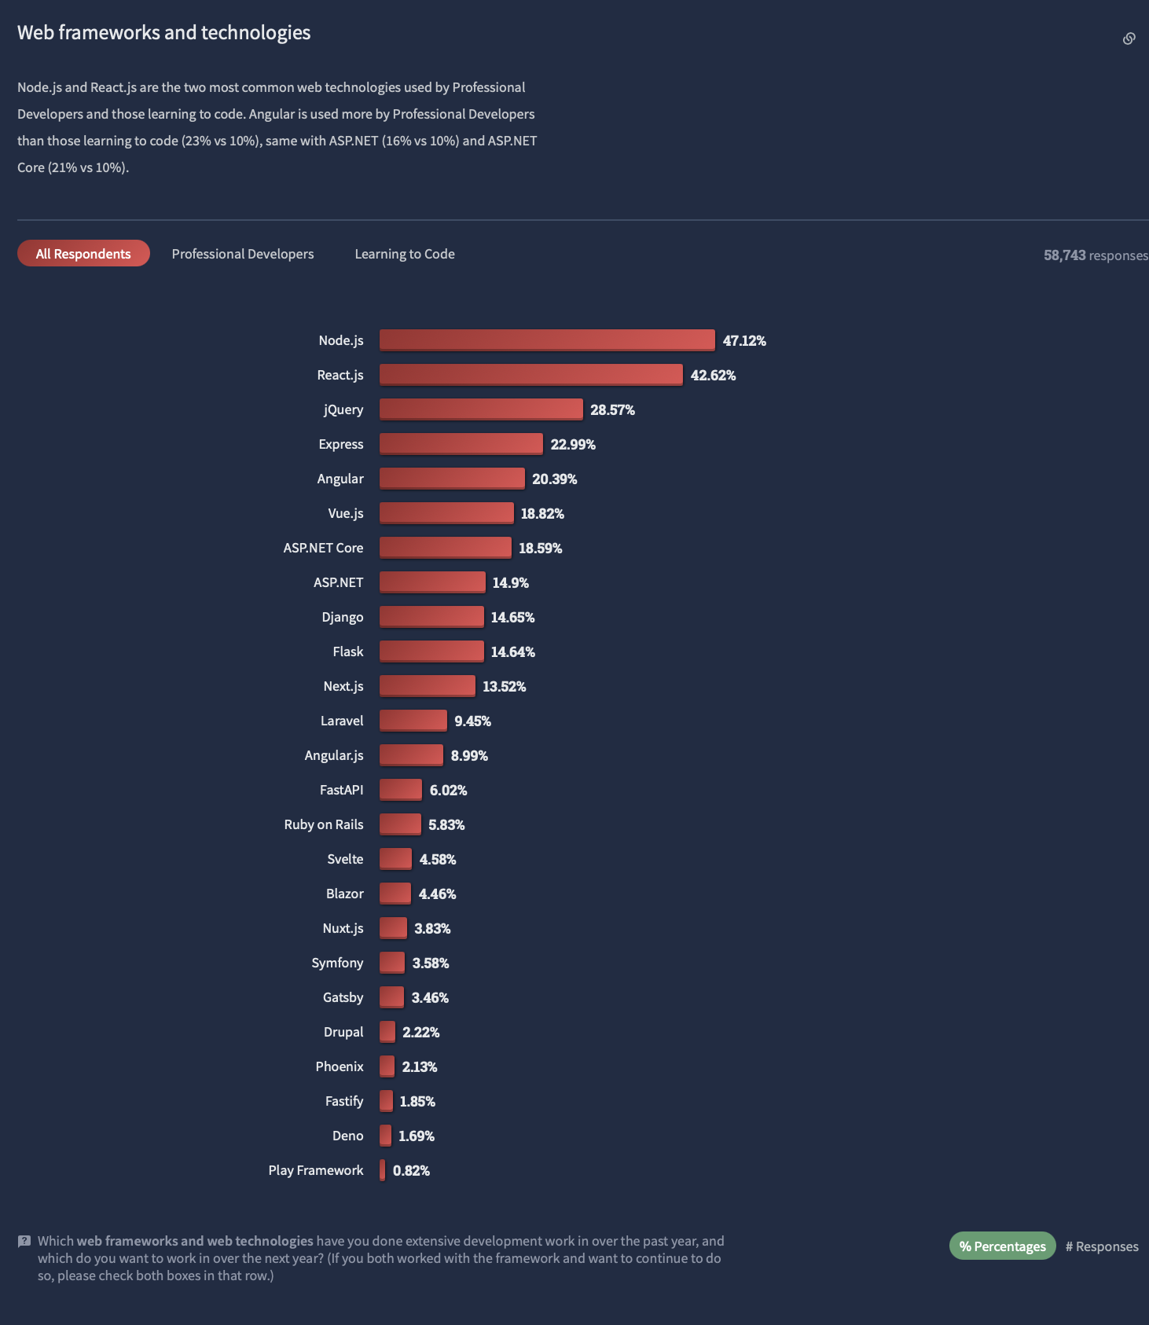
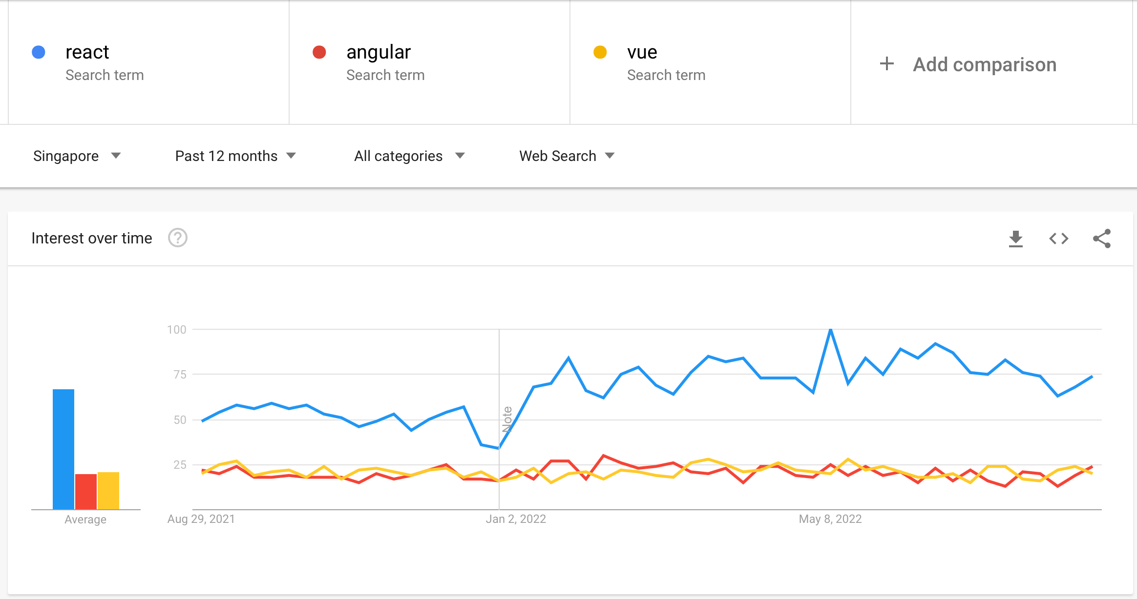
Trends

Slide 7




Stack
M
E
R
N

Slide 8
What is React?

Slide 9
React is a JavaScript library for building user interfaces

Slide 10
React is developed by Facebook

Slide 11
Declarative
Each line of code declares what each element of the app is.

Slide 12
Component-based
Build reusable UI elements and Javascript functions that accepts inputs

Slide 13
Header Component
Content Component
Sidebar
Component
Content Component
Content Component

Slide 14
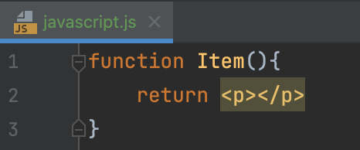



JSX is used to describe how the interface should look like

Slide 15
Two Types of Components
1. Class-based
2. Functional

Slide 16
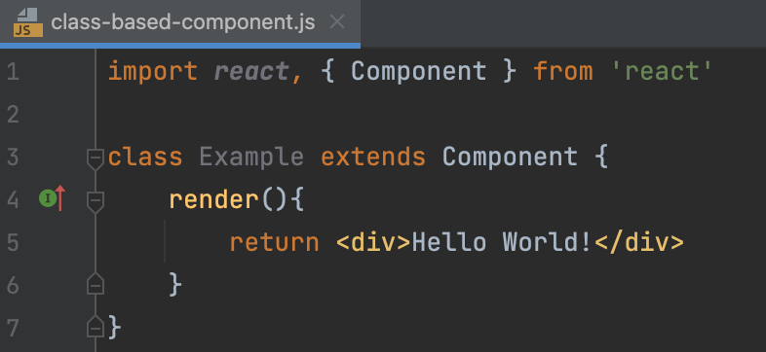
Class-based

Slide 17
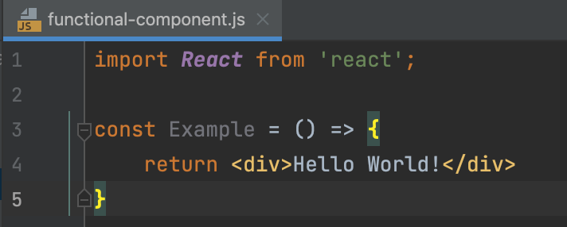
Functional

Slide 18
How to use React?

Slide 19
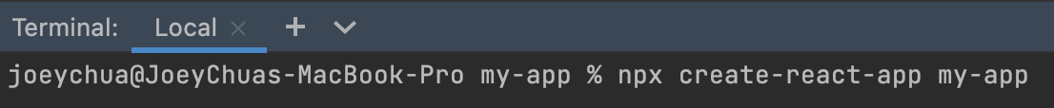
React Environment Setup
Manually set up using webpack & babel
Use create-react-app command

Slide 20
Create-react-app is a simple tool or command that generates required files & folders to start the application

Slide 21

Node is a Javascript runtime that allows us to execute JS code on the server

Slide 22
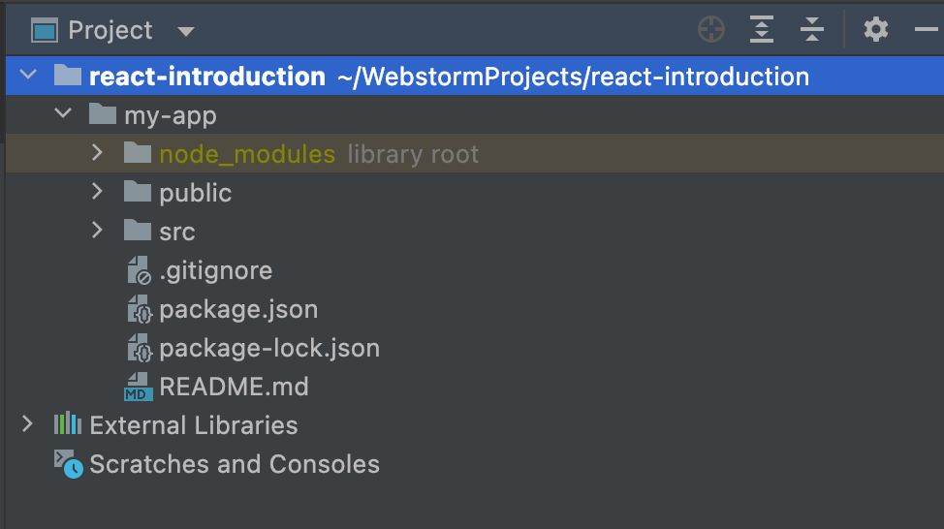
Files and Folders
node_modules: Source code for dependencies. Do not touch.
public: The directory where your static files are stored
src: index.js, app.js etc.
public
package.json: The main file that defines the dependencies and other settings for the project

Slide 23
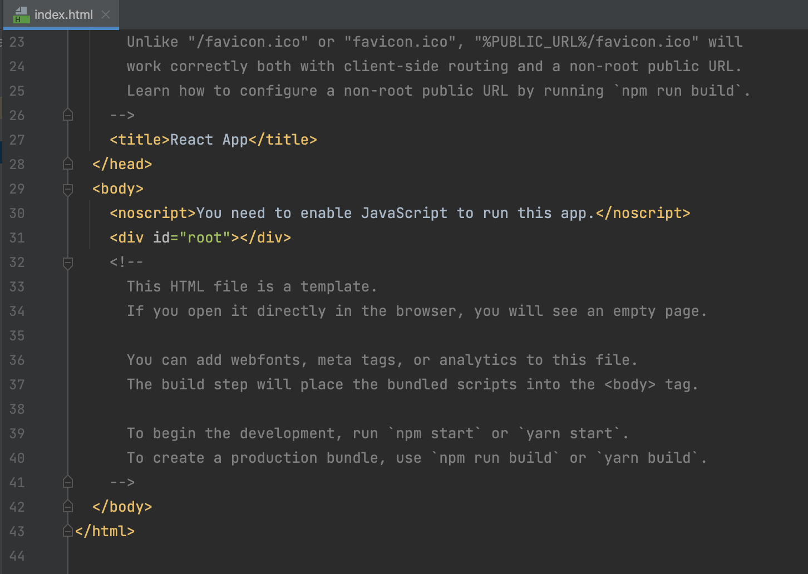
Index.html
React app is mounted here
Root

Slide 24
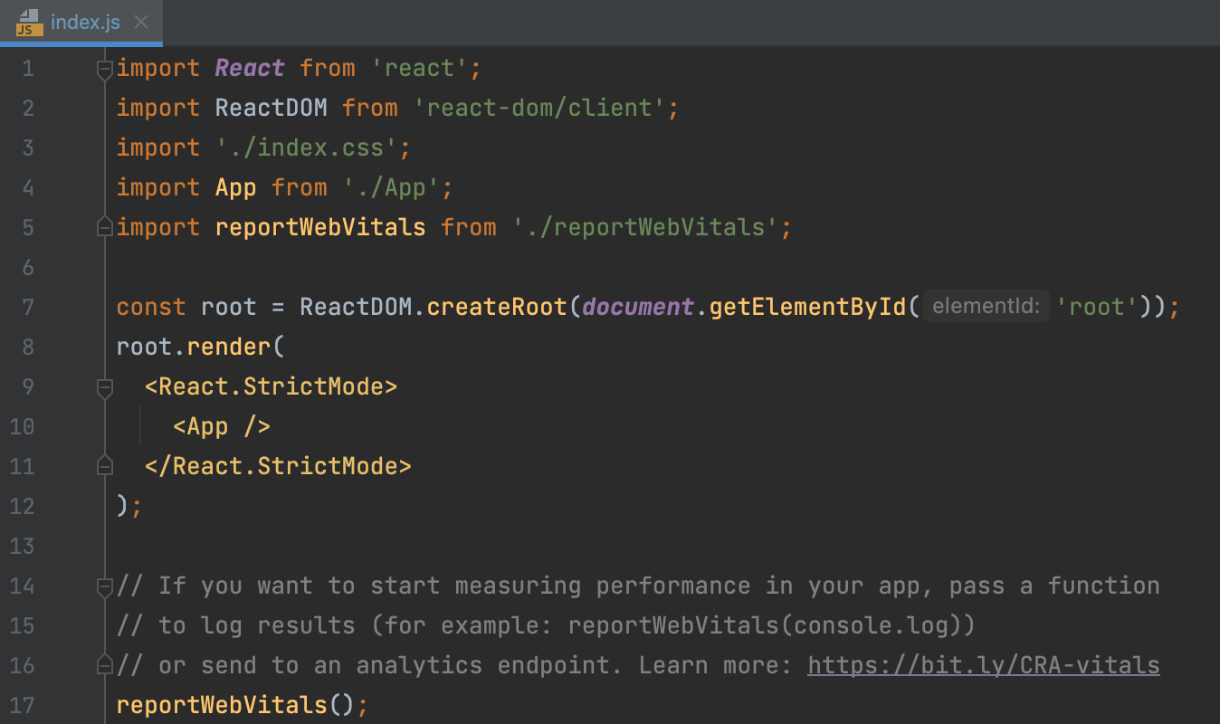
Index.js
We have ReactDOM to render the application with ID root
Index.css
HTML
React App

Slide 25
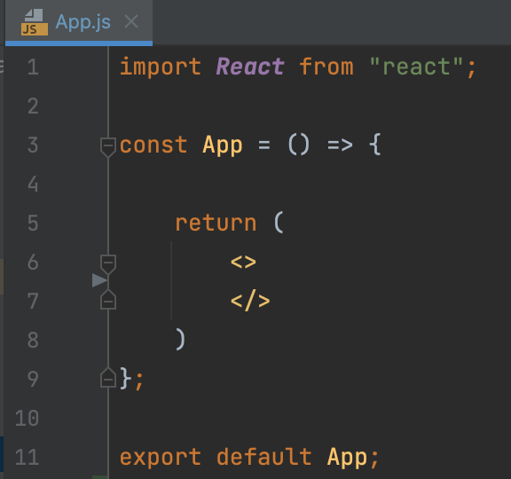
App.js
In HTML, we write class but in JSX we will write className
Function
Note! You only export 1 component from each file
Export

Slide 26
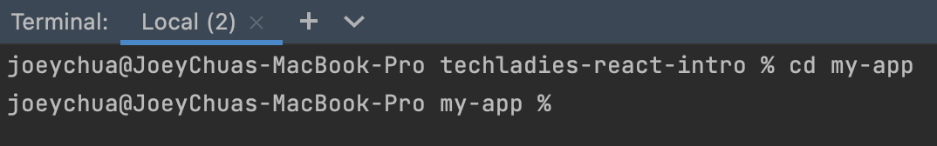
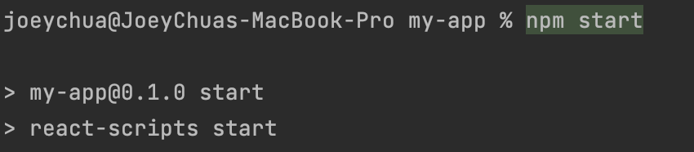
Terminal
Change Directory
Start Server

Slide 27
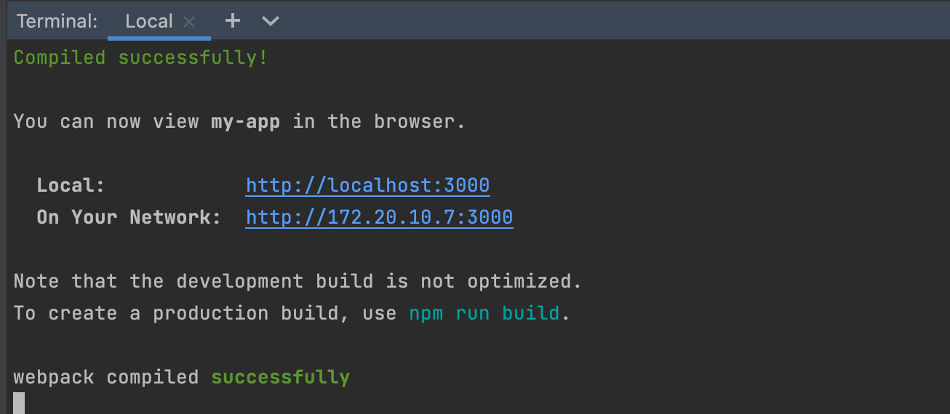
Terminal

Slide 28
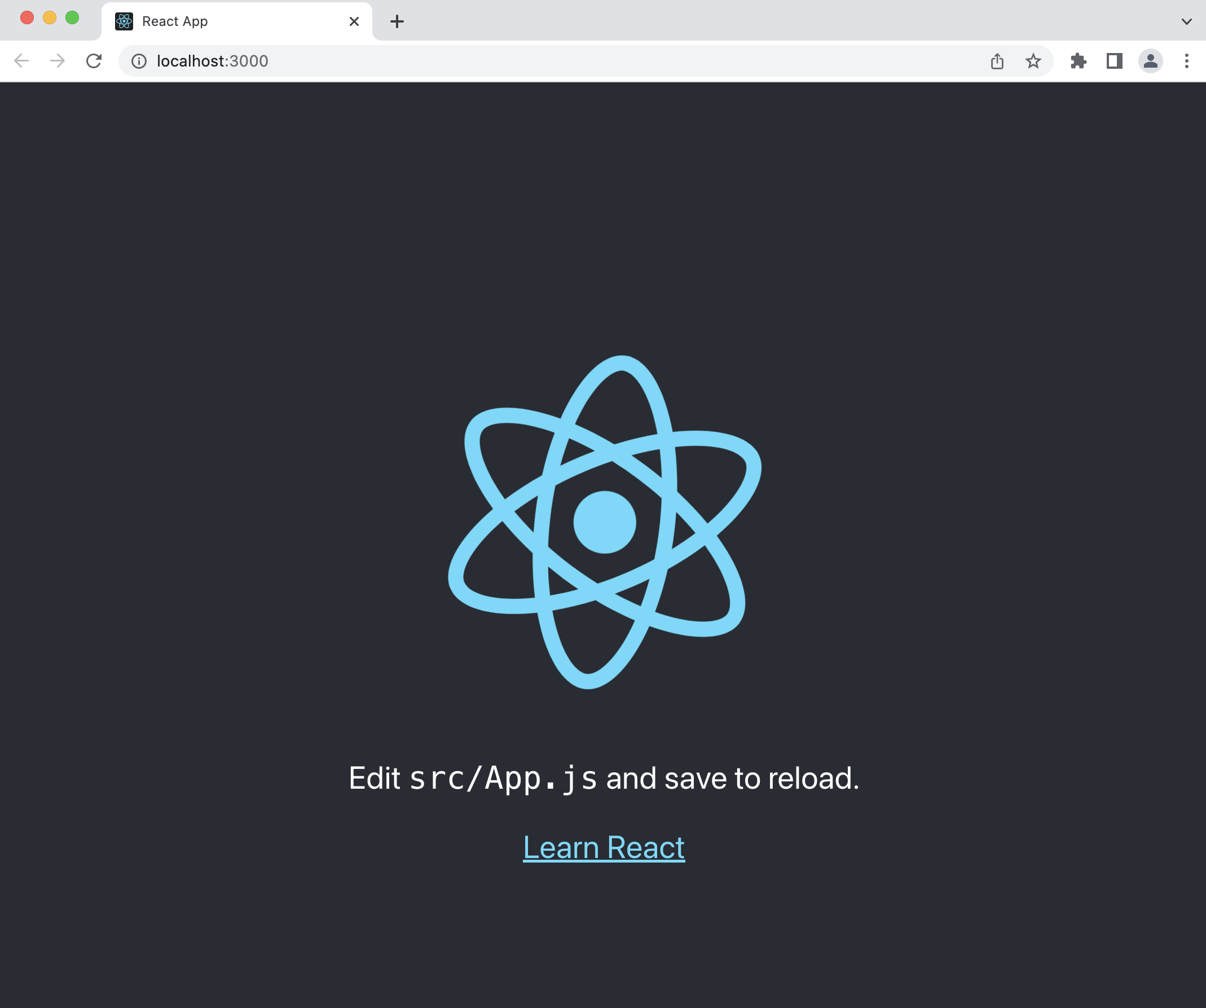
LocalHost

Slide 29
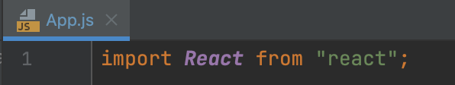
App.js
To use the library, we need to import React

Slide 30
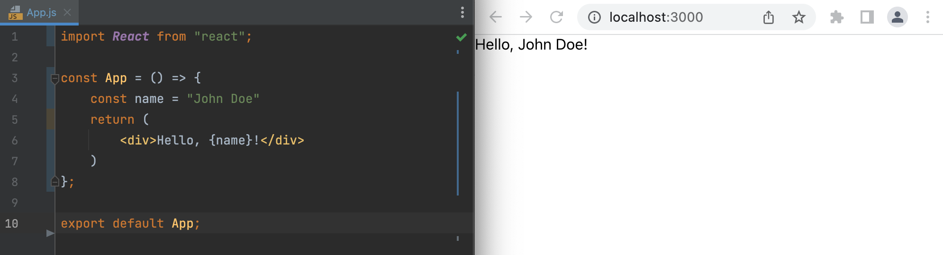
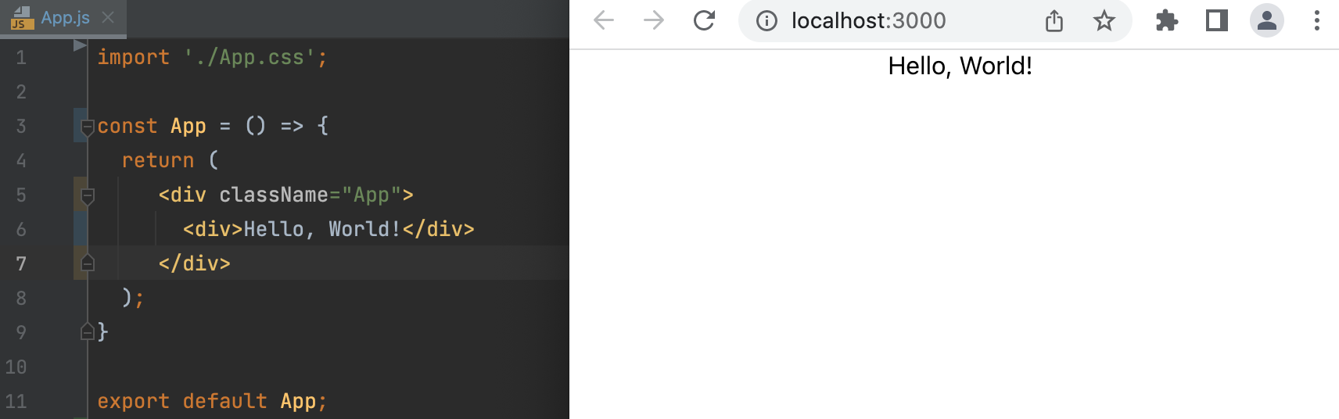
App.js
App.js
Delete function and change to const
Delete function and change to const

Slide 31
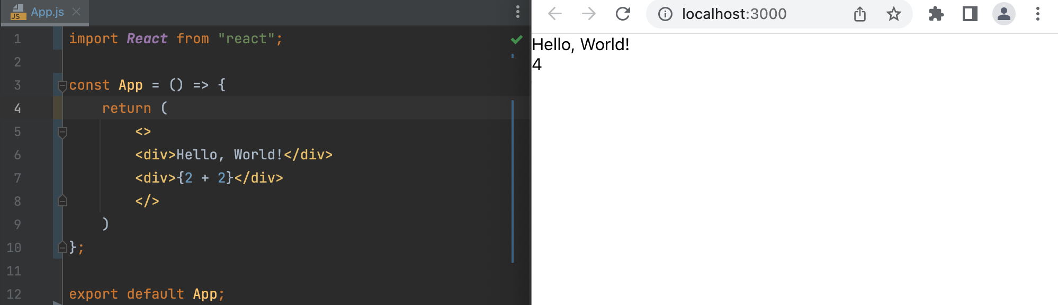
App.js
Dynamic
JSX is used to describe how the interface should look like

Slide 32
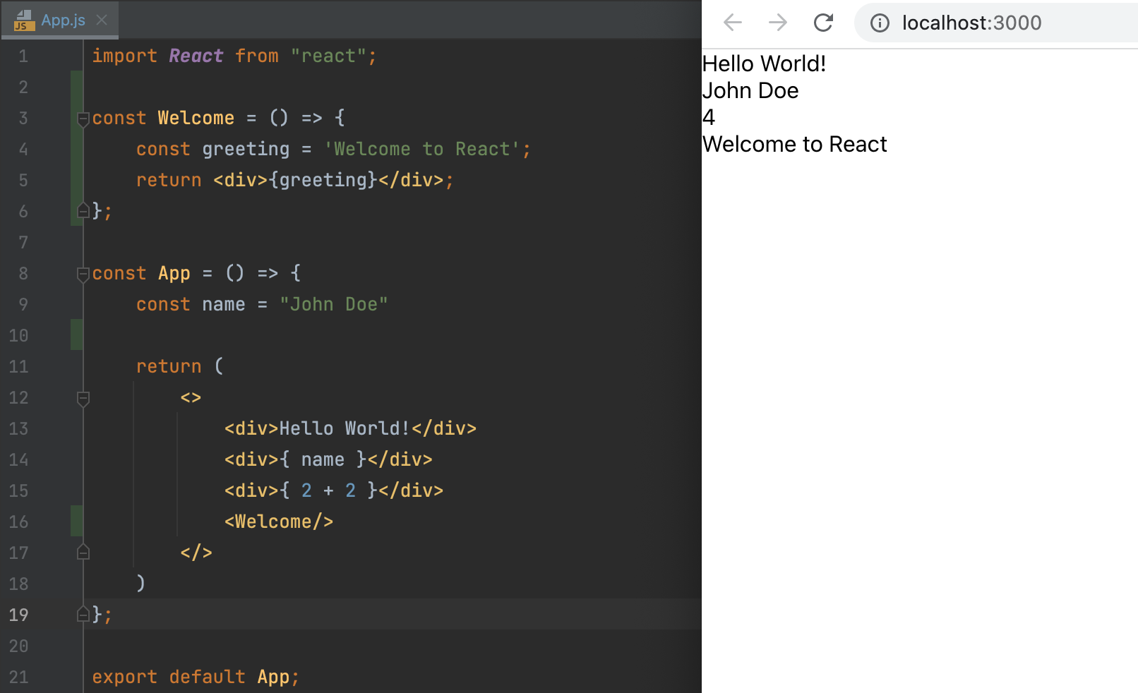
App.js
Props Destructuring
JSX is used to describe how the interface should look like

Slide 33
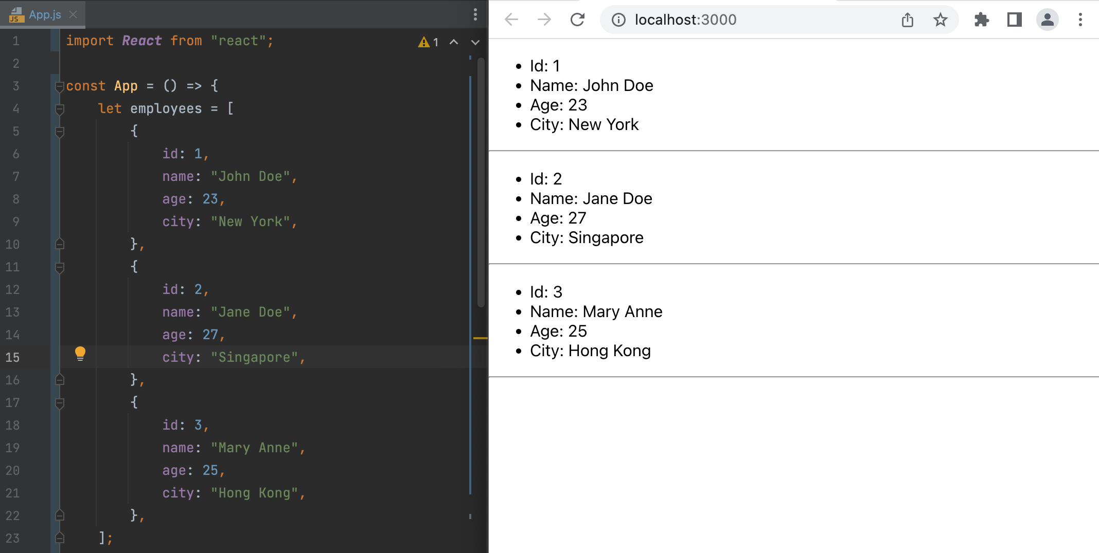
App.js
List and Keys

Slide 34
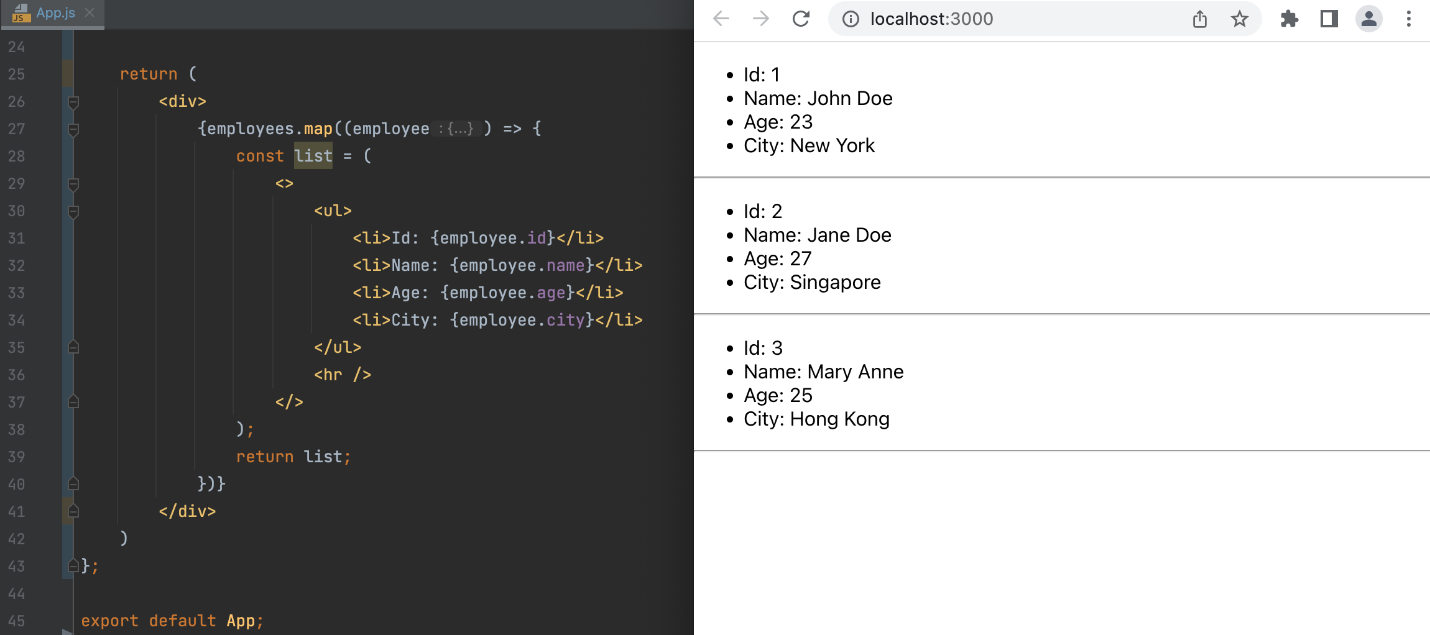
App.js
List and Keys

Slide 35
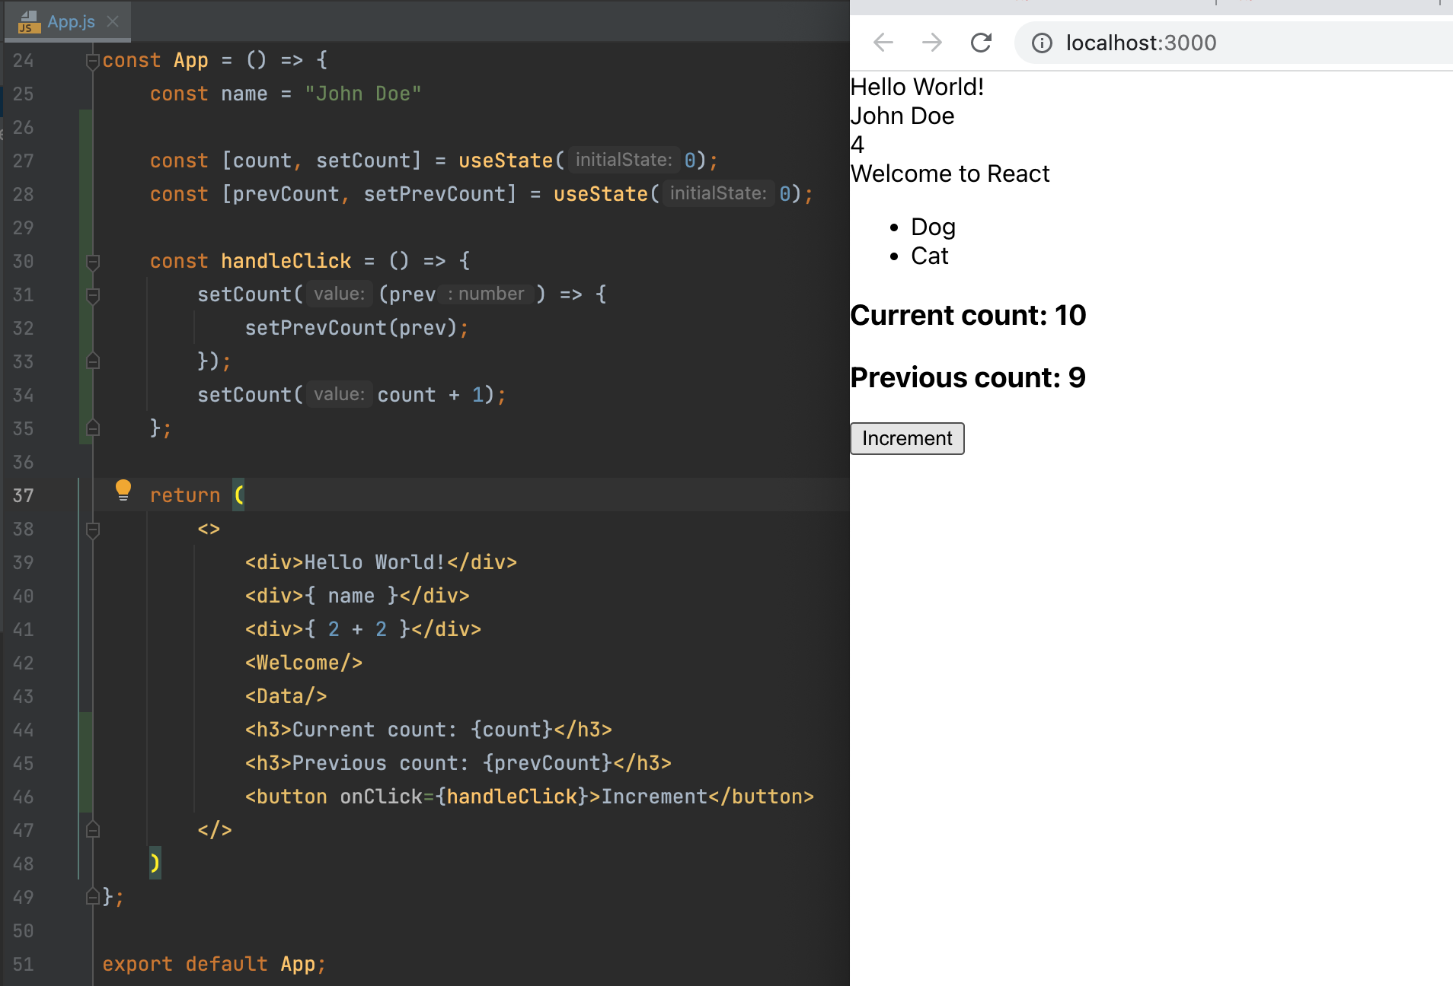
App.js
State

Slide 36
App.js
State Hook

Slide 37
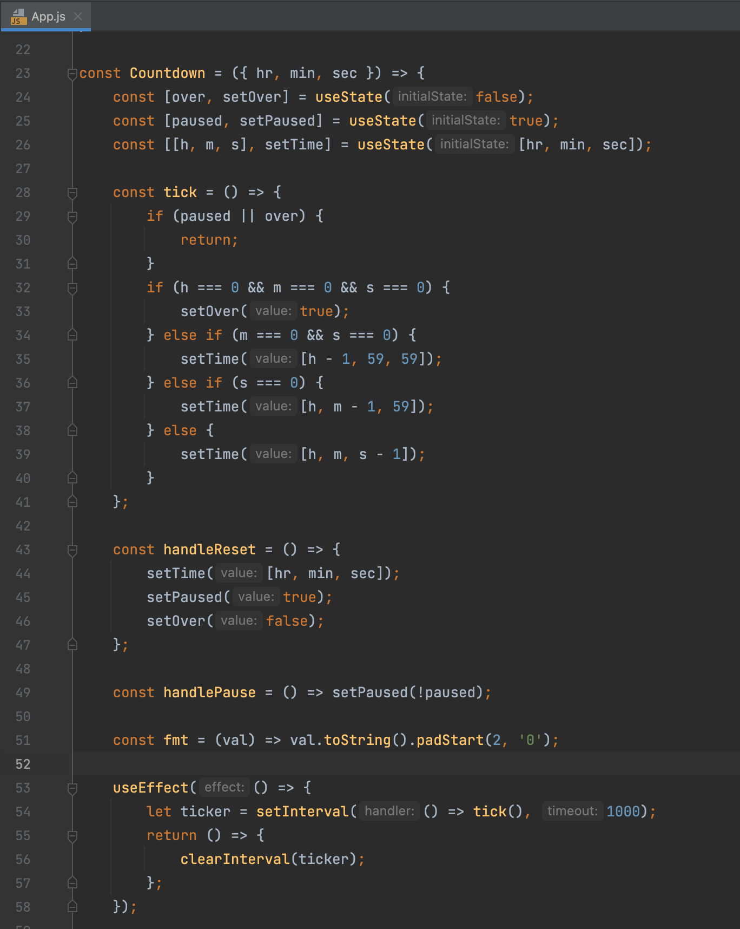
App.js
Effect Hook

Slide 38

Hands-on
https://pokeapi.co

Slide 39
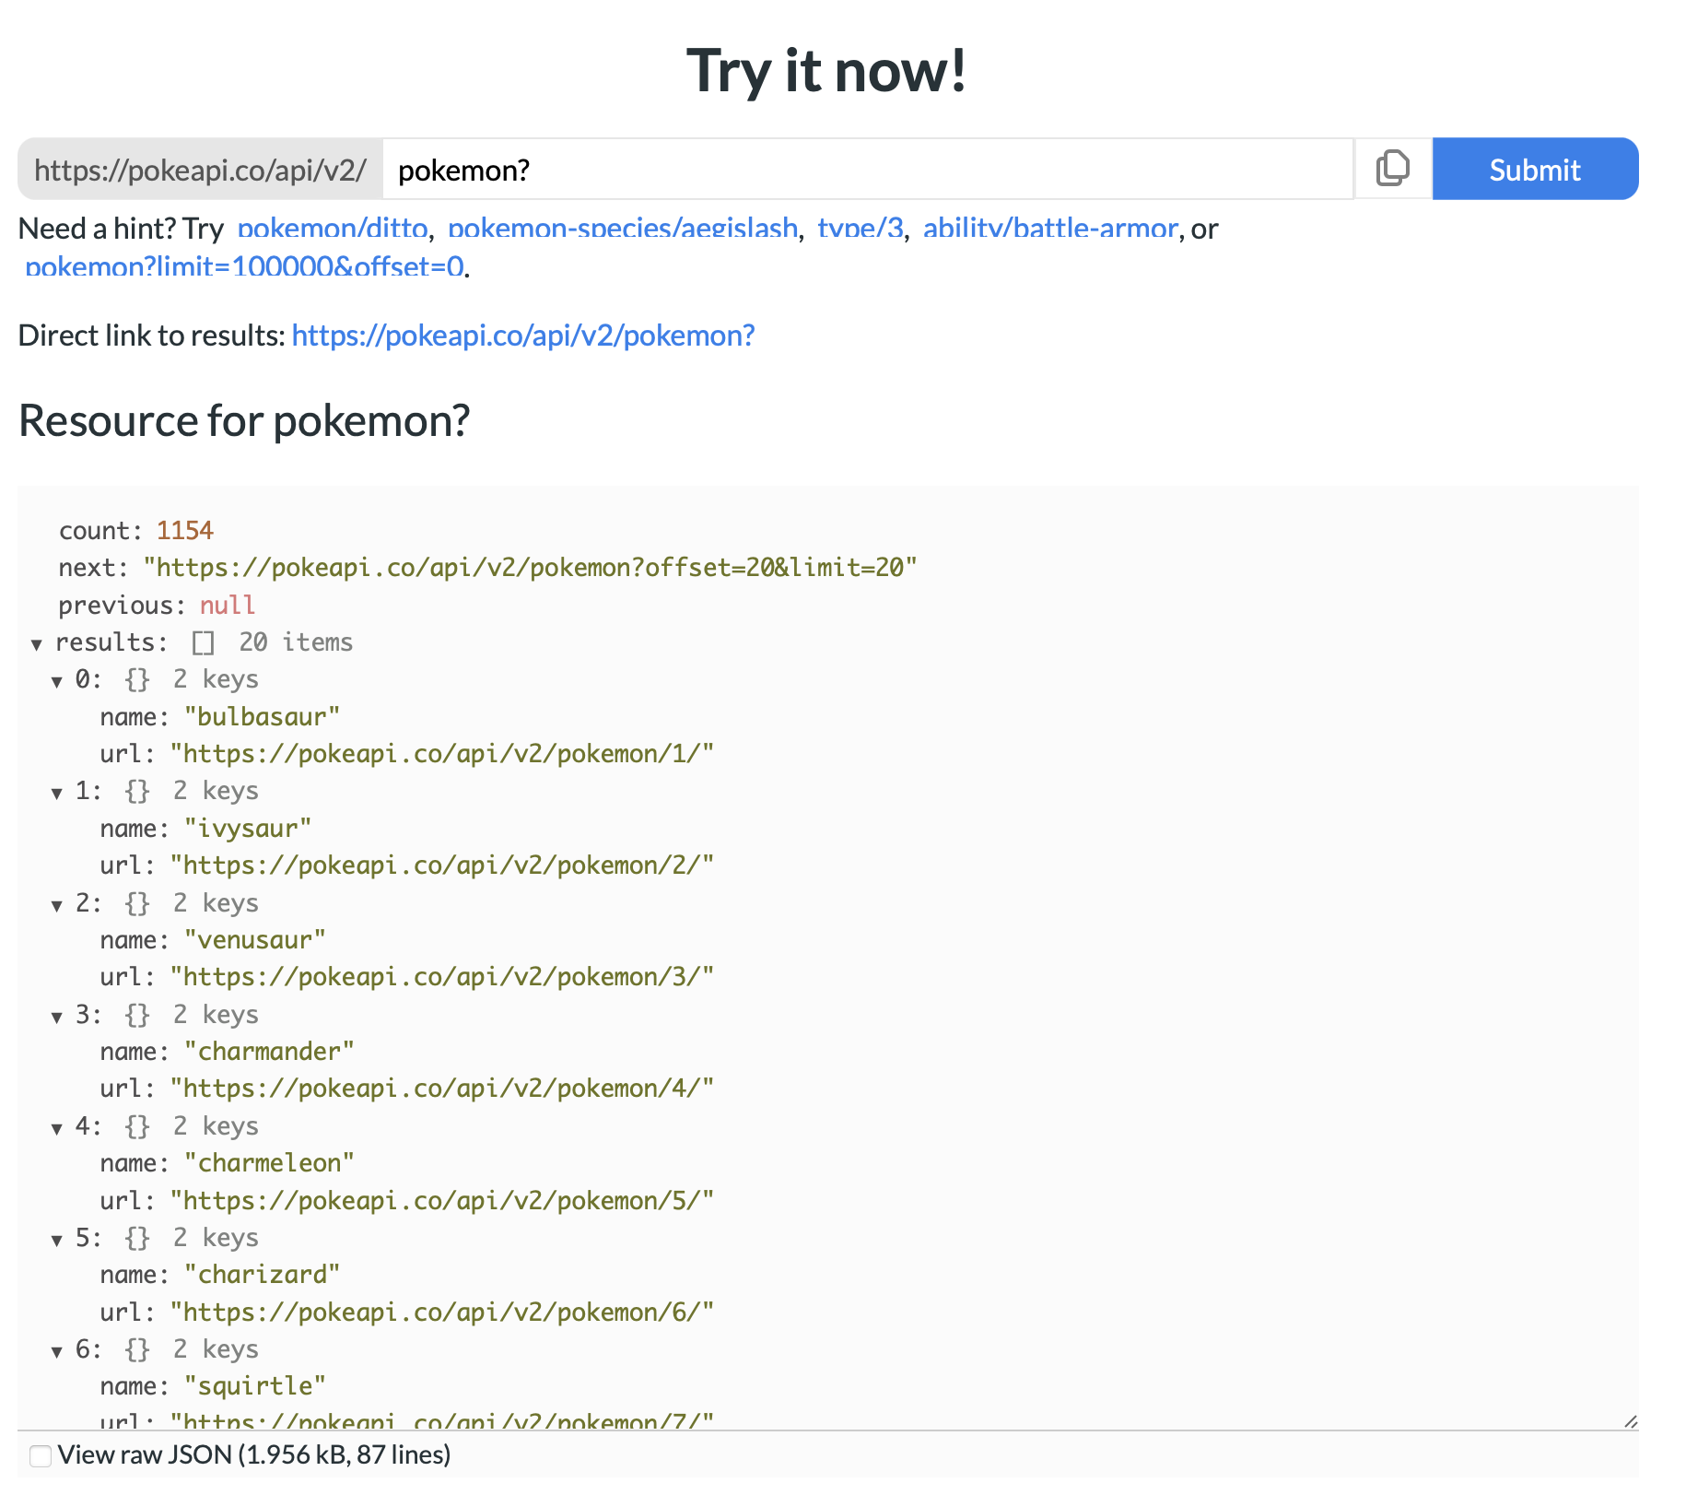
API

Slide 40
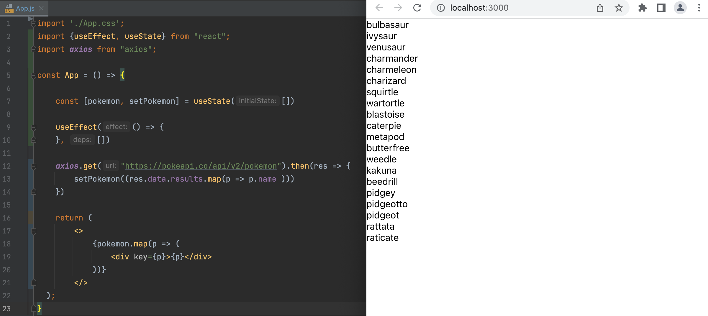
App.js
Axios, useEffect, useState, map

Slide 41
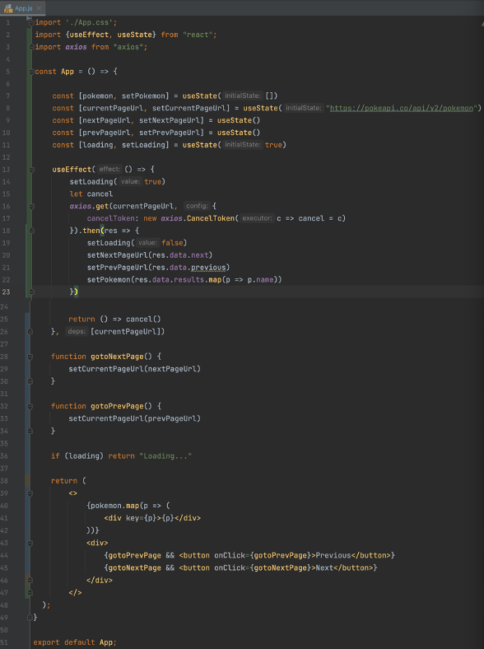
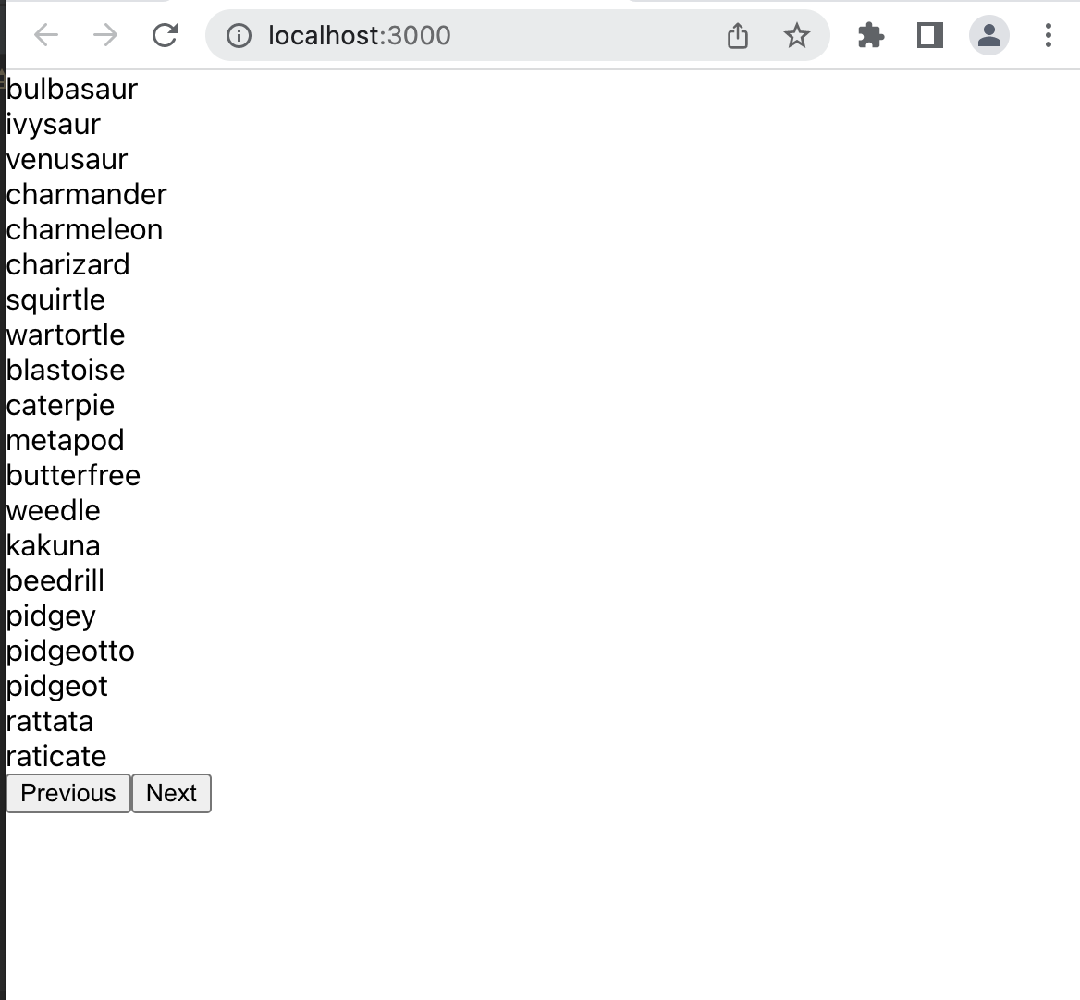
App.js
Pagination

